Slide 1
Determine whether a Rubik’s Cube is solvable without moving
DavidGuo

Slide 2
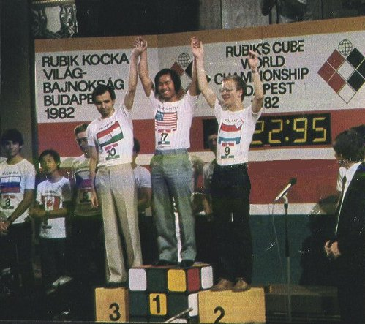
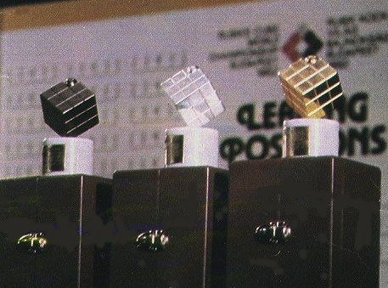
History
Ernö Rubik
"How could the blocks move independently without falling apart?"
Hungarian patent in January 1975.
The first world championship took place on June 5, 1982 in Budapest.
World Rubik's Cube Championship 2007

Slide 3
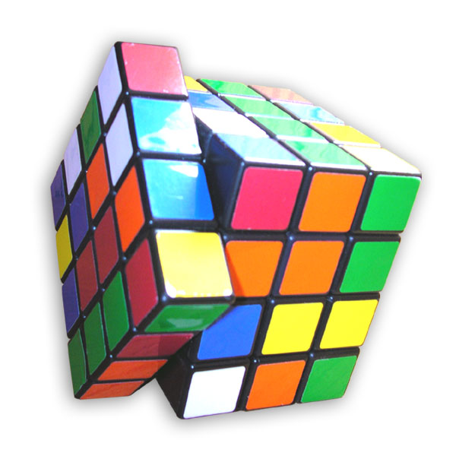
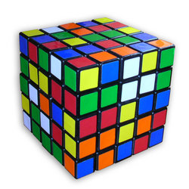
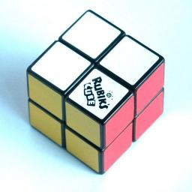
Cube Revenge
Proffessor Cube
Mini Cube

Slide 4
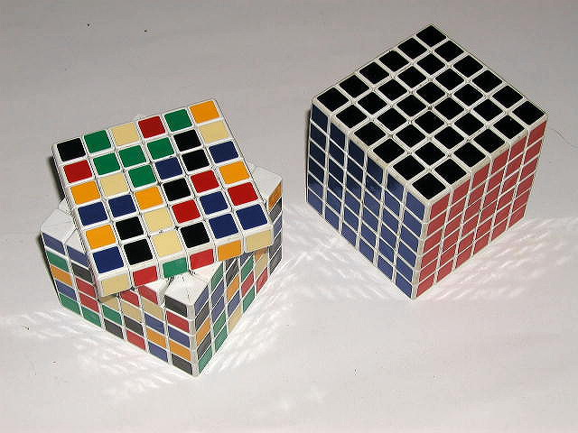
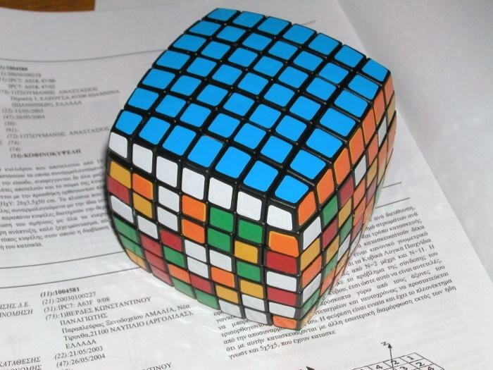
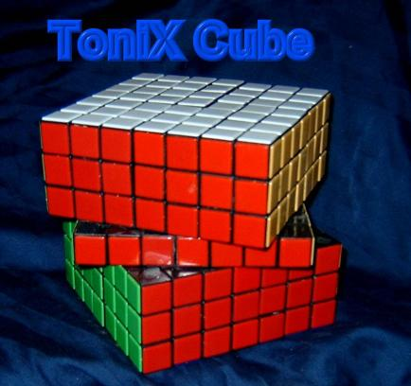
6x6x6 Cube
7x7x7 Cube?

Slide 5
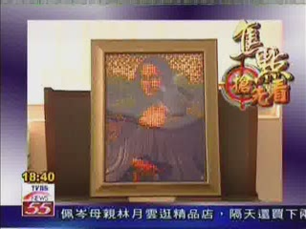
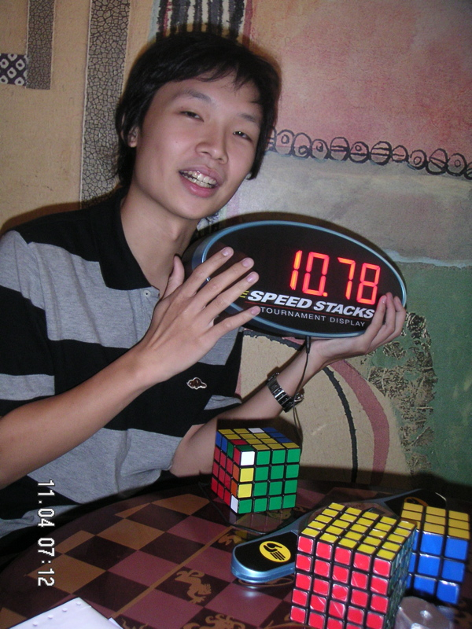


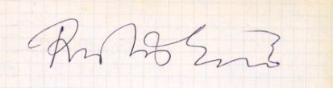
Famous person
趙承宗
鄭維駿(weijiunn)
陸嘉宏(aaaboy)
馮於懋(omega)
DavidGuo
Prof. Jessica Fridrich

Slide 6
Fewest move
Alexander H. Frey, Jr. and David Singmaster. Handbook of Cubik Math. Enslow Publishers, 1982.
  At least 17 moves. At most 52 moves.
  Conjecture: “God’s number” is in the low 20’s.
Michael Reid.
  Superflip requires 20 face turns.
Silviu Radu.
  Rubik can be solved in 27f.
Daniel Kunkle and Gene Cooperman, 26 Moves Suffice for Rubik's Cube, Proc. of International Symposium on Symbolic and Algebraic Computation (ISSAC '07), ACM Press, 2007, to appear.
  Gene Cooperman, Larry Finkelstein, and Namita Sarawagi. Applications of Cayleygraphs. In AAECC: Applied Algebra, Algebraic Algorithmsand Error-Correcting Codes, InternationalConference, pages 367-378 LNCS, Springer-Verlag, 1990.

Slide 7
Main Result
Number the orientation.
1
2
3
2
3
1

Slide 8

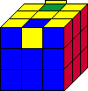
Orientation
Corner Orientation
  ∑ mod 3=0
Edge Orientation
  ∑ mod 2=0

Slide 9
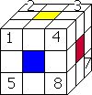
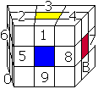
Permutation
Must be even.
, ,

Slide 10
Decompose into 3-cycle
(1 2 3 4 5 6 7 8)
=(1 2 3)(1 4 5)(1 6 7)(18)
(1 2)(3 4)=(123)(143)
How many subgroups?

Slide 11
Remark
There are
Cube subgroups.

Slide 12
Problem
is even.
n*n*n Rubik’s Cube.
Improve the bound.

Slide 13
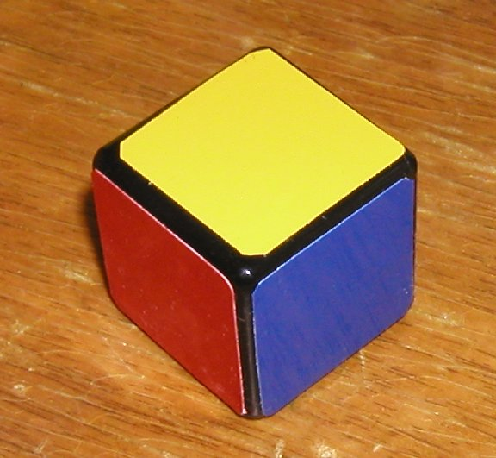
Thank you

