Slide 1




主辦單位： 合作夥伴：

Slide 2
寓數學於魔方
DavidGuo
師大數學系 郭君逸 助理教授

Slide 3
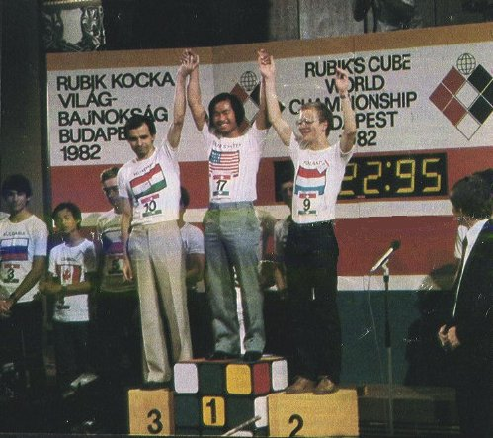
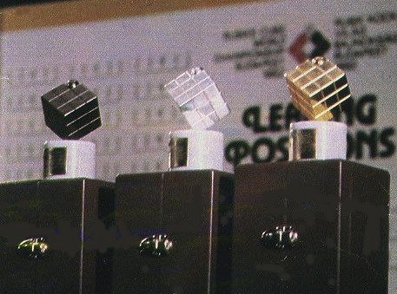
History
Ernö Rubik
"How could the blocks move independently without falling apart?"
Hungarian patent in January 1975.
The first world championship took place on June 5, 1982 in Budapest.
世界各地比賽

Slide 4
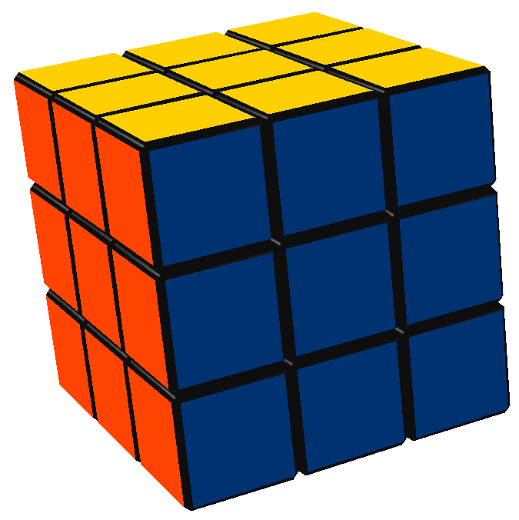
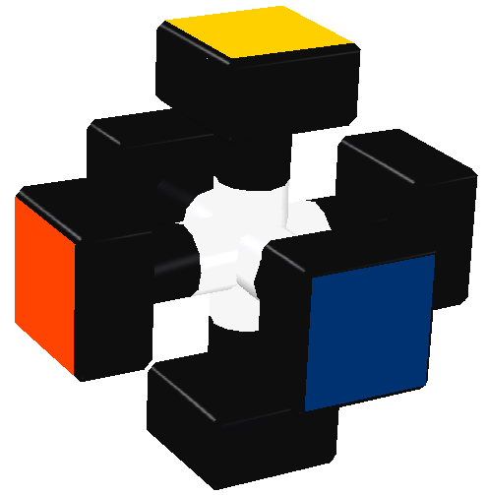
Rubik’s Cube
魔術方塊、扭力骰
結構：
世界紀錄：
  Single: 7.08, Erik Akkersdijk, Netherlands, Czech Open 2008.
  Average: 11.28, Yu Nakajima, Japan, 2008.
  11.36 10.16 10.65 13.13 11.83

Slide 5
其他比賽項目
Blindfolded
  54.22, Rafal Guzewicz, Poland, Polish Open 2008.
One-handed
  14.56, Yu Nakajima, Japan, Tokyo Open 2008.
  19.88, Ryan Patricio, USA, San Diego Open 2008.
With feet
  36.94, Chang Jee-Hoon, Korea, Suwon Open 2008.
  52.25, Chang Jee-Hoon, Korea, Suwon Open 2008.
Fewest moves
  28, Mirek Goljan, Czech, Caltech Winter 2005.
  28, Zbigniew Zborowski, Poland, Polish Open 2006.
詳細規則

Slide 6
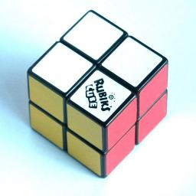
2x2x2 Cube
Mini Cube, Pocket Cube.
世界紀錄：
  Single: 1.63, Javier París, Spain, Murcia Open 2008.
  Average: 3.63, Lukasz Cialon, Poland, Polish Open 2008.
  3.13 3.43 6.25 4.11 3.36

Slide 7
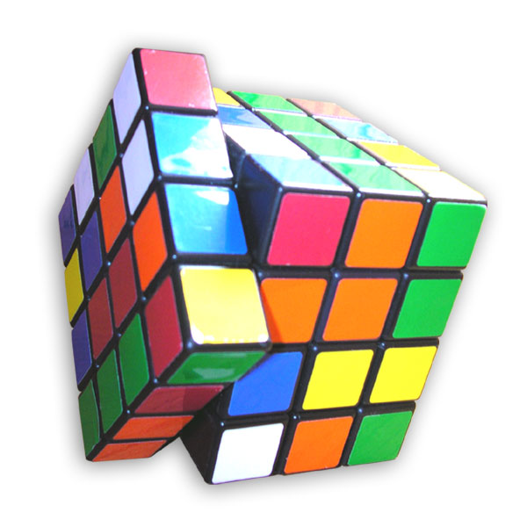
4x4x4 Cube
Cube Revenge
世界紀錄：
  45.15, Keisuke Hiraya, Japan, Tokyo Open 2008.
  52.31, Keisuke Hiraya, Japan, Tokyo Open 2008.
  58.28 52.80 58.65 45.84 45.15
Blindfolded
  5:26.03 Mátyás Kuti, Hungary Swedish Cube Day 2007.(DNF)
  6:20.96 Chris Hardwick, USA, Virginia Open 2007.

Slide 8
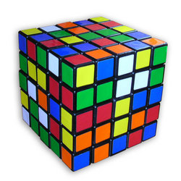
5x5x5 Cube
Professor Cube
世界紀錄：
  1:20.98, Dan Cohen, USA, US Nationals and Open 2008.
  1:29.40, Dan Cohen, USA, US Nationals and Open 2008.
  1:30.58 1:24.40 1:45.88 1:20.98 1:33.23
Blindfolded
  10:05.00, Mátyás Kuti, Hungary, Czech Open 2007.(DNF)
  15:22.00, Chris Hardwick, USA, Washington DC Open 2008.

Slide 9
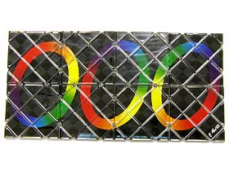
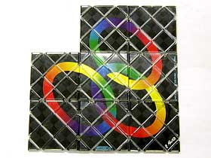
Rubik’s Magic
世界紀錄：
  0.86s, Mátyás Kuti, Hungary, Belgian Open 2007 and 2008.
  0.96s, Mátyás Kuti, Hungary, Belgian Open 2007.
  2.06 0.94 1.05 0.86 0.88

Slide 10
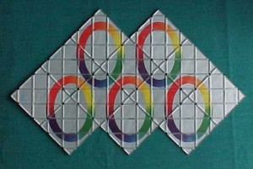
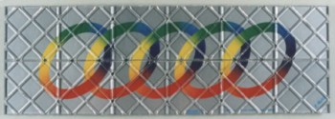
Rubik’s Master Magic
世界紀錄：
  1.72s, Mátyás Kuti, Hungary, Belgian Open 2008.
  1.96s, Mátyás Kuti, Hungary, Polish Open 2007.

Slide 11
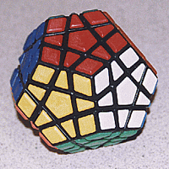
Megaminx
1:01.78, Erik Akkersdijk, Netherlands, Belgian Open 2008.
1:07.70, Erik Akkersdijk, Netherlands, Belgian Open 2008.

Slide 12
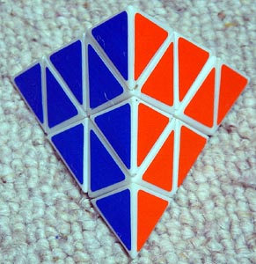
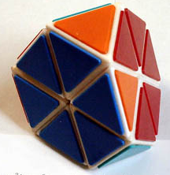
Pyraminx
2.83, Tomasz Kiedrowicz, Poland, Gdansk Open 2008.
4.39, Yohei Oka, Japan, Tokyo Open 2008.
Tetraminx

Slide 13
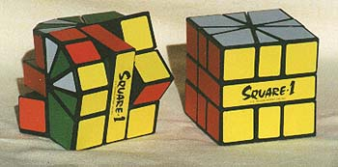
Square-1
13.56, Grzegorz Prusak, Poland, Polish Open 2007.
17.77, Kang Ji-Jon, Korea, Cheonan 2008.

Slide 14
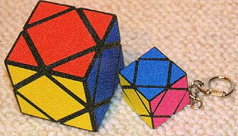
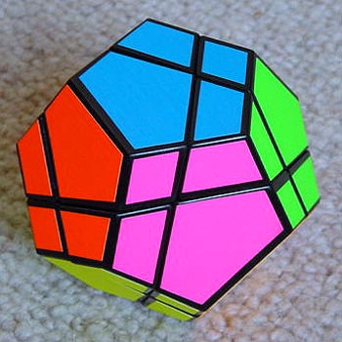
其他方塊
圖片來源：Puzzle-Museum
Skewb
Dodecahedron

Slide 15
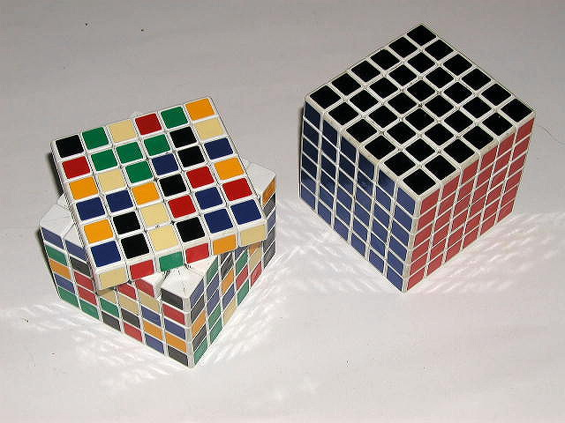
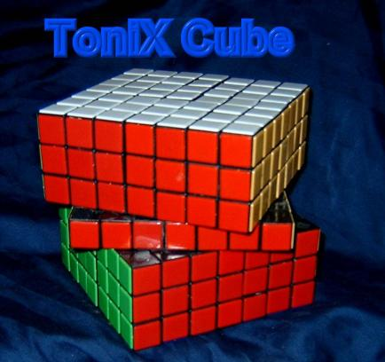
高階方塊
6x6x6 Cube
7x7x7 Cube?

Slide 16
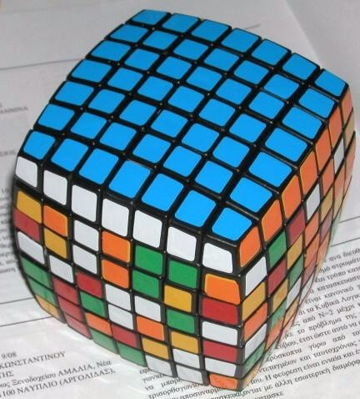
方塊製作限制
做成圓弧狀
7*7的方塊，角
會完全露在外面
當方塊轉45度角時
1
2

Slide 17
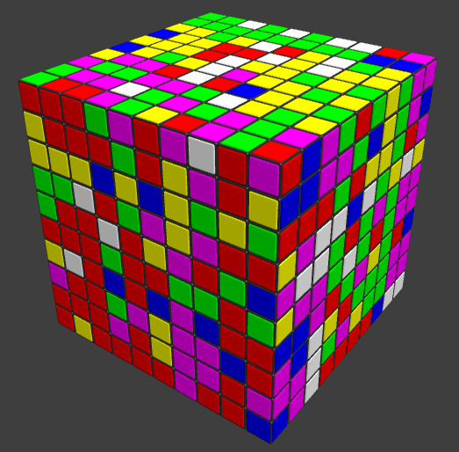

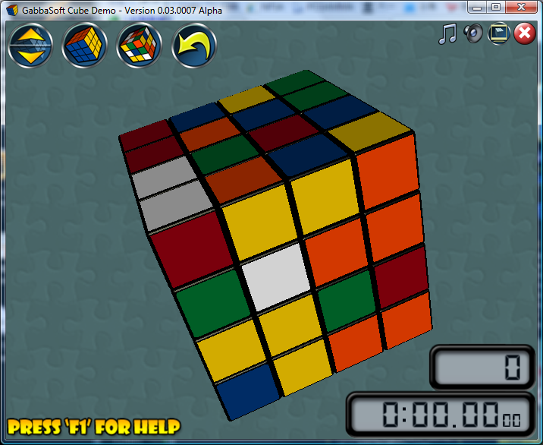
電腦模擬N階方塊
Gliding Cube
  http://www.glidingcube.com/
  http://www.gabbasoft.com/

Slide 18
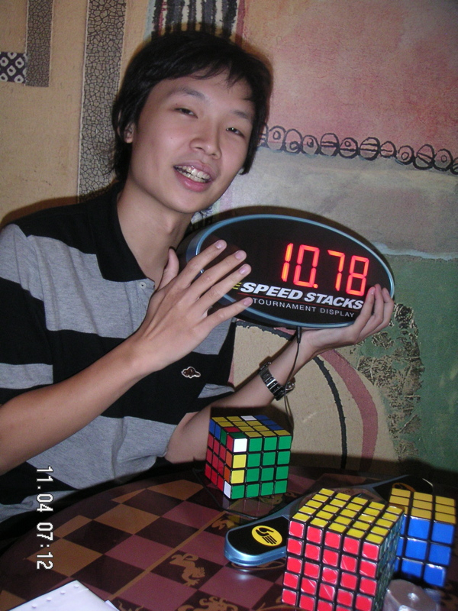
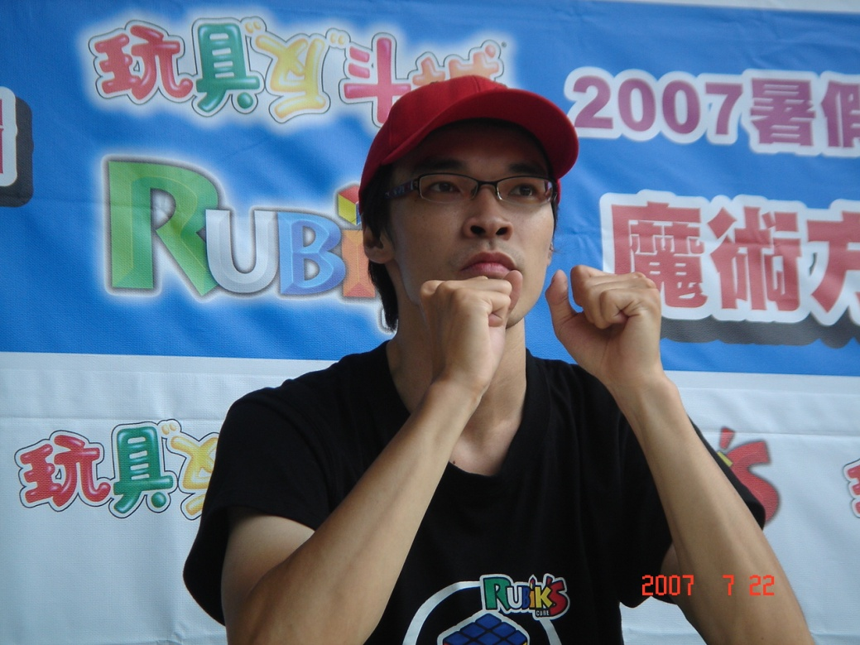
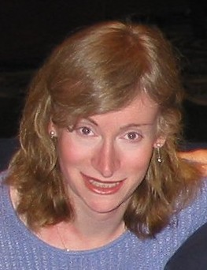
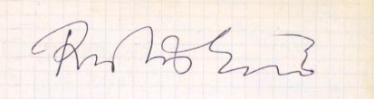
Famous person
趙承宗
鄭維駿(weijiunn)
陸嘉宏(aaaboy)
Prof. Jessica Fridrich
郭滄海 教授
DavidGuo

Slide 19
教材教法
便於記憶、記錄
  圖示
  數字
能完成為優先，立即引發興趣
大班教學效果下降不多
容易複習

Slide 20
Remark
There are
Cube subgroups.

Slide 21
Fewest move
任意的魔術方塊，在幾步內可以完成呢？
Alexander H. Frey, Jr. and David Singmaster. Handbook of Cubik Math. Enslow Publishers, 1982.
  At least 17 moves. At most 52 moves.
  Conjecture: “God’s number” is in the low 20’s.
Cube Explorer : 找最佳解
  Florida Institute of Technology: Robot.

Slide 22
Fewest move
Michael Reid.
  Lower bounds: Superflip requires 20 face turns. (1995)
  Upper bounds: New upper bounds. (1995)
    Face turn metric(FTM): 29 moves.
    Quarter turn metric(QTM): 42 moves.

Slide 23
Fewest move
Daniel Kunkle and Gene Cooperman, 26 Moves Suffice for Rubik's Cube, Proc. of International Symposium on Symbolic and Algebraic Computation (ISSAC '07), ACM Press, 2007.
  FTM: 26 moves.
  Gene Cooperman, Larry Finkelstein, and Namita Sarawagi. Applications of Cayleygraphs. In AAECC: Applied Algebra, Algebraic Algorithmsand Error-Correcting Codes, InternationalConference, pages 367-378 LNCS, Springer-Verlag, 1990.
    FTM: 11 moves.
    QTM: 14 moves.

Slide 24
Fewest move
Silviu Radu.
  Rubik can be solved in 27f. (2006)
  Paper. (June 30, 2007)
    Face turn metric(FTM): 27 moves.
    Quarter turn metric(QTM): 34 moves.
  Using GAP(Groups, Algorithms, Programming):
  a System for Computational Discrete Algebra

Slide 25
Fewest move
Tomas Rokicki.
  25 Moves Suffice for Rubik’s Cube. (2008)
  23 Moves Suffice for Rubik’s Cube. (2008)

Slide 26
解法

Slide 27
魔方中的數學

Slide 28
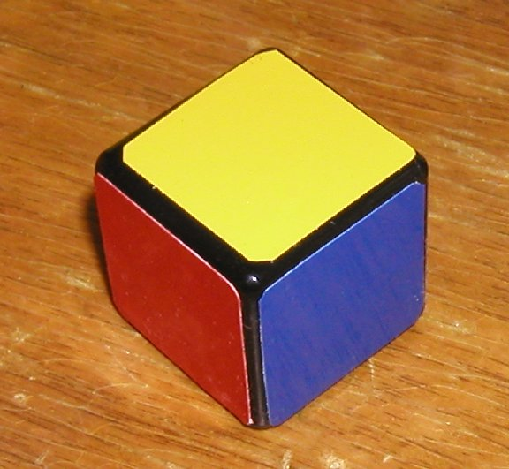
Thank you
http://www.davidguo.idv.tw/Cube

