Slide 1
魔術方塊簡介
DavidGuo
交大應數 郭君逸 助理教授

Slide 2
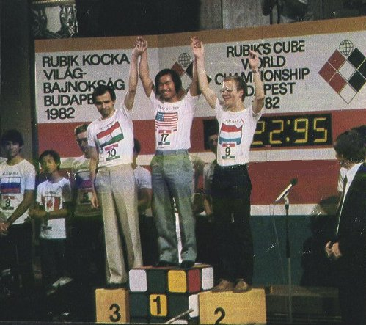
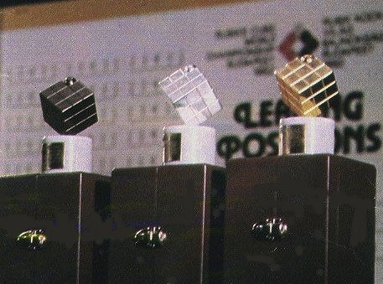
History
Ernö Rubik
"How could the blocks move independently without falling apart?"
Hungarian patent in January 1975.
The first world championship took place on June 5, 1982 in Budapest.
World Rubik's Cube Championship 2007

Slide 3
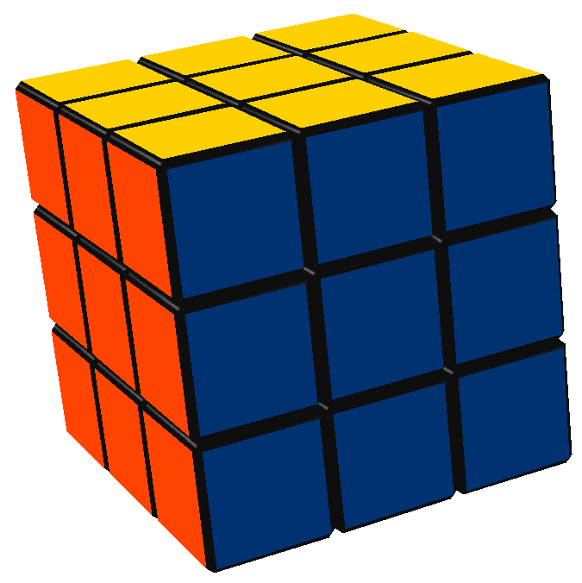
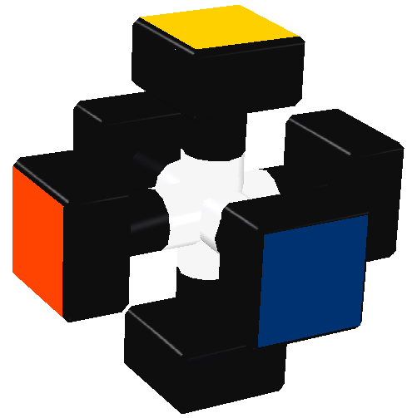
Rubik’s Cube
香港：扭力骰
結構：
世界紀錄：
  Single: 9.55s, Ronvan Bruchem, Netherlands, 2007.
  Average: 11.76s, Yu Jeong-Min, Korea, 2007.

Slide 4
其他比賽項目
Blindfolded
  54.83s, Mátyás Kuti, Hungary, Czech Open 2007.
One-handed
  15.81s, Thibaut Jacquinot, France, Murcia Open 2007.
  20.58s, Rama Temmink, Netherlands, Benelux Open 2008.
With feet
  39.88s, Anssi Vanhala, Finland, Finnish Open 2007.
  52.46s, Anssi Vanhala, Finland, Finnish Open 2007.
Fewest moves
  28, Mirek Goljan, Czech, Caltech Winter 2005.
  28, Zbigniew Zborowski, Poland, Polish Open 2006.
詳細規則

Slide 5
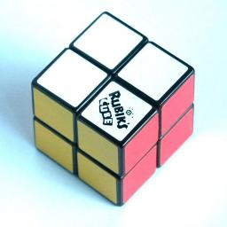
2x2x2 Cube
Mini Cube, Pocket Cube.
世界紀錄：
  2.65s, Ron van Bruchem, Netherlands, UK Open 2007.
  3.91s, Lukasz Cialon, Poland, World Championship 2007.

Slide 6
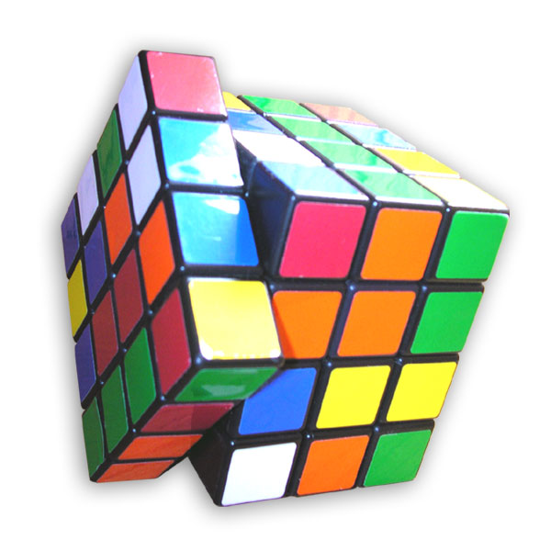
4x4x4 Cube
Cube Revenge
世界紀錄：
  46.63s, Mátyás Kuti, Hungary, UK Open 2007.
  54.71s, Erik Akkersdijk, Netherlands, Benelux Open 2008.
Blindfolded
  5:26.03 Mátyás Kuti Hungary Swedish Cube Day 2007

Slide 7
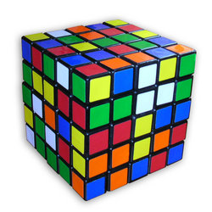
5x5x5 Cube
Professor Cube
世界紀錄：
  1:28.66, Erik Akkersdijk, Netherlands, Belgian Open 2008.
  1:36.02, Erik Akkersdijk, Netherlands, Belgian Open 2008.
Blindfolded
  10:05.00, Mátyás Kuti, Hungary, Czech Open 2007.

Slide 8
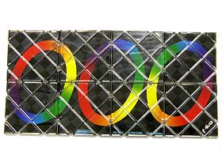
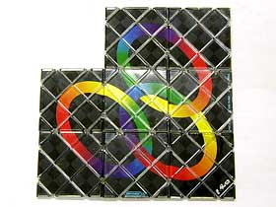
Rubik’s Magic
世界紀錄：
  0.86s, Mátyás Kuti, Hungary, Belgian Open 2007 and 2008.
  0.96s, Mátyás Kuti, Hungary, Belgian Open 2007.

Slide 9
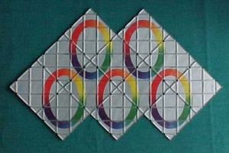
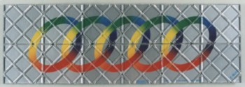
Rubik’s Master Magic
世界紀錄：
  1.72s, Mátyás Kuti, Hungary, Belgian Open 2008.
  1.96s, Mátyás Kuti, Hungary, Polish Open 2007.

Slide 10
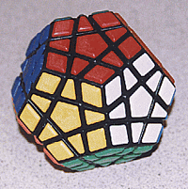
Megaminx
1:01.78, Erik Akkersdijk, Netherlands, Belgian Open 2008.
1:07.70, Erik Akkersdijk, Netherlands, Belgian Open 2008.

Slide 11
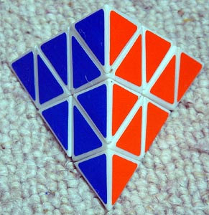
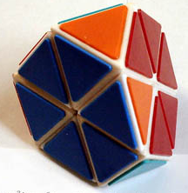
Pyraminx
4.18, Piotr Kózka, Poland, Polish Open 2006.
5.98, Grzegorz Luczyna, Poland, Polish Open 2007.
Tetraminx

Slide 12
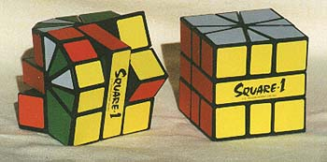
Square-1
13.56, Grzegorz Prusak, Poland, Polish Open 2007.
19.57, Grzegorz Prusak, Poland, Polish Open 2007.

Slide 13
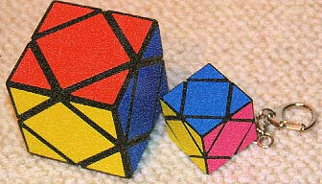
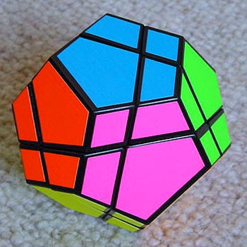
其他方塊
圖片來源：Puzzle-Museum
Skewb
Dodecahedron

Slide 14
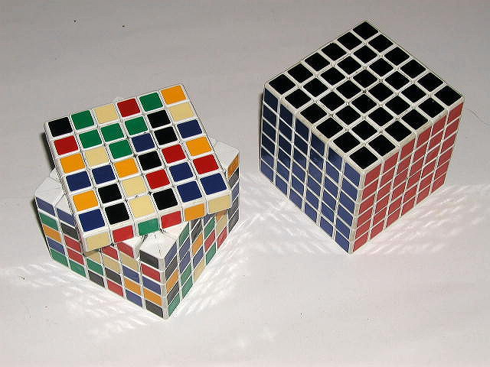
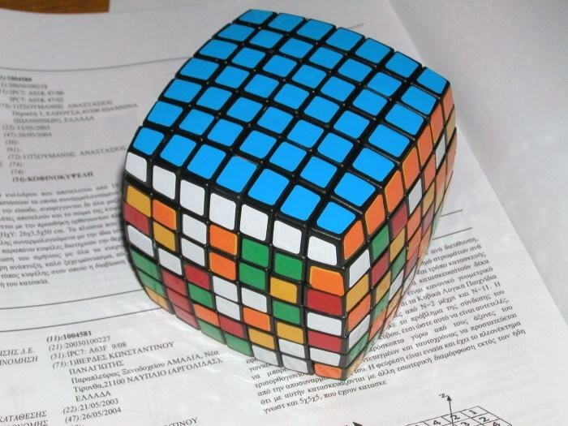
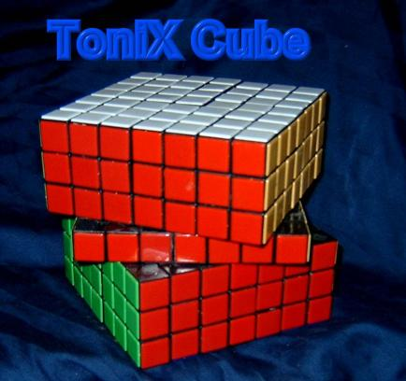
高階方塊
6x6x6 Cube
7x7x7 Cube?

Slide 15
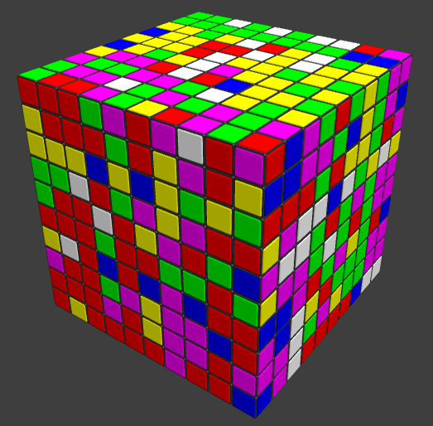
N階方塊
電腦模擬：Gliding Cube
  http://www.glidingcube.com/

Slide 16
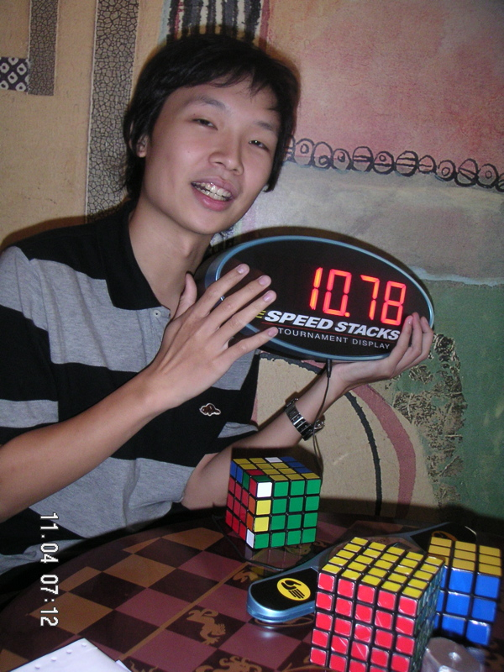
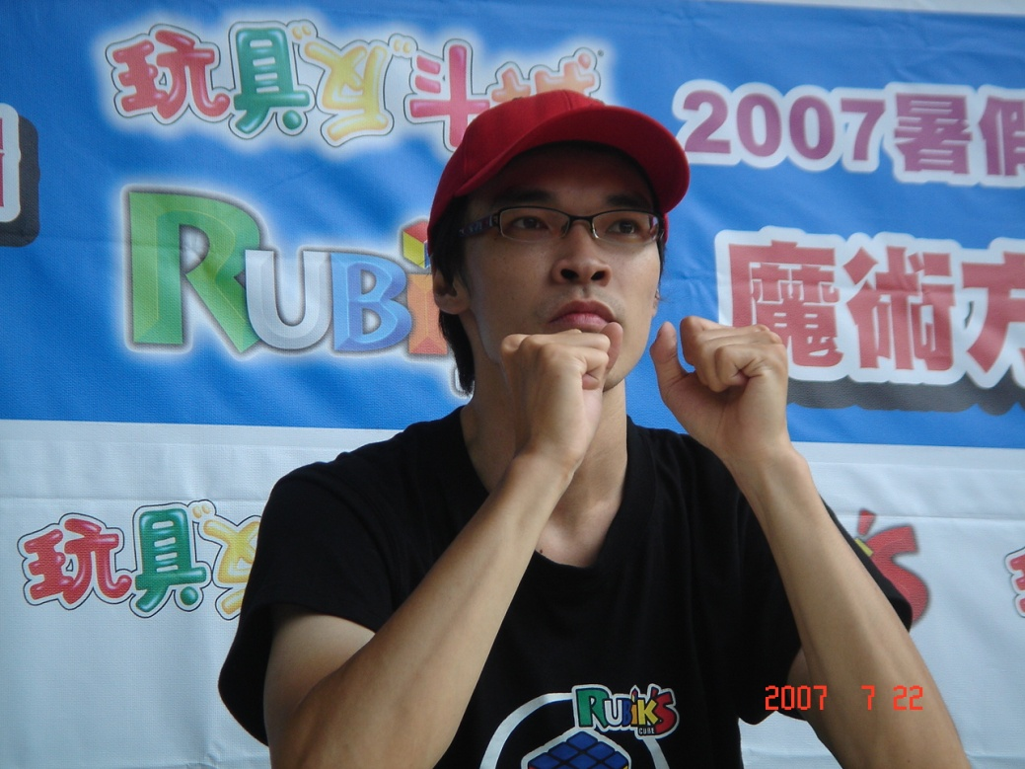
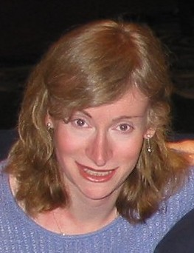
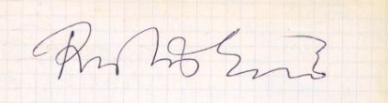
Famous person
趙承宗
鄭維駿(weijiunn)
陸嘉宏(aaaboy)
Prof. Jessica Fridrich
許技江(rehearttw)
DavidGuo

Slide 17
Fewest move
Alexander H. Frey, Jr. and David Singmaster. Handbook of Cubik Math. Enslow Publishers, 1982.
  At least 17 moves. At most 52 moves.
  Conjecture: “God’s number” is in the low 20’s.
Michael Reid.
  Superflip requires 20 face turns.
Silviu Radu.
  Rubik can be solved in 27f.
Daniel Kunkle and Gene Cooperman, 26 Moves Suffice for Rubik's Cube, Proc. of International Symposium on Symbolic and Algebraic Computation (ISSAC '07), ACM Press, 2007, to appear.
  Gene Cooperman, Larry Finkelstein, and Namita Sarawagi. Applications of Cayleygraphs. In AAECC: Applied Algebra, Algebraic Algorithmsand Error-Correcting Codes, InternationalConference, pages 367-378 LNCS, Springer-Verlag, 1990.

Slide 18
方塊的購買
官網：www.rubiks.com
  玩具反斗城
Mefferts: mefferts.com
魚大：www.unicube.tw
東賢實業
Cubesmith: www.cubesmith.com
批踢踢：Rubiks版
各大文具店、十元商店

Slide 19
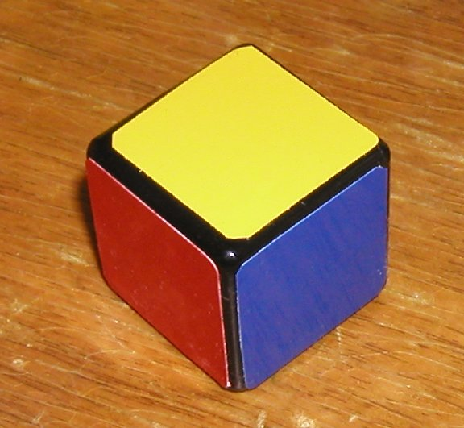
Thank you

